Slide 1


MASS MAIL DISPATCHER
Exposys Data Labs Internship
Zikra Maryam Siddiqui

Slide 2


Domain- WEB DEVELOPMENT
Title - Mass Mail Dispatcher

Slide 3
Table of contents
Abstract
Introduction
Proposed method with Architecture
Technologies used
Implementation
Conclusion

Slide 4
Abstract
Mass Mail Dispatcher are easy ways to send a mail to a large group of people at the same time.
But along with instant email sending, the mail ids are also needed to be verified.
This proposed mass mail dispatcher system will provide both the facility at the same time.

Slide 5
Introduction
Mass Mail Dispatcher is a web based application designed to send mass mails to all the recipients uploaded through a CSV file
The purpose is to provide a tool to control and send emails to a vast number of recipients.
The application will list and sort out all the valid and invalid emails detected by the application allowing the users to more readily send emails as per user convenience
This application provides a user friendly interface to send multiple emails and also verify valid and invalid email ids.
This website is made using HTML,CSS and Javascript.

Slide 6

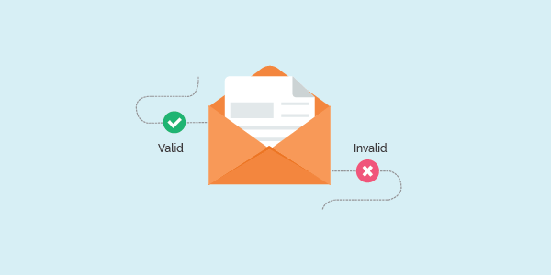
Proposed method with Architecture
A text/CSV file will be uploaded which will analyze valid and invalid mail ids.
It will control and send out emails to a vast number of recipients.
Allows real-time messaging
Enables marketers to send personalized messages save your precious time.
Leads to increased conversions.
Offers information sharing

Slide 7

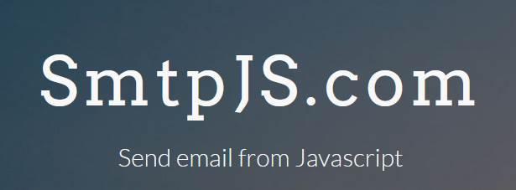
Technologies used
HTML
CSS
JAVASCRIPT
SMTP – A JS library which is used to send email using client-side javascript

Slide 8
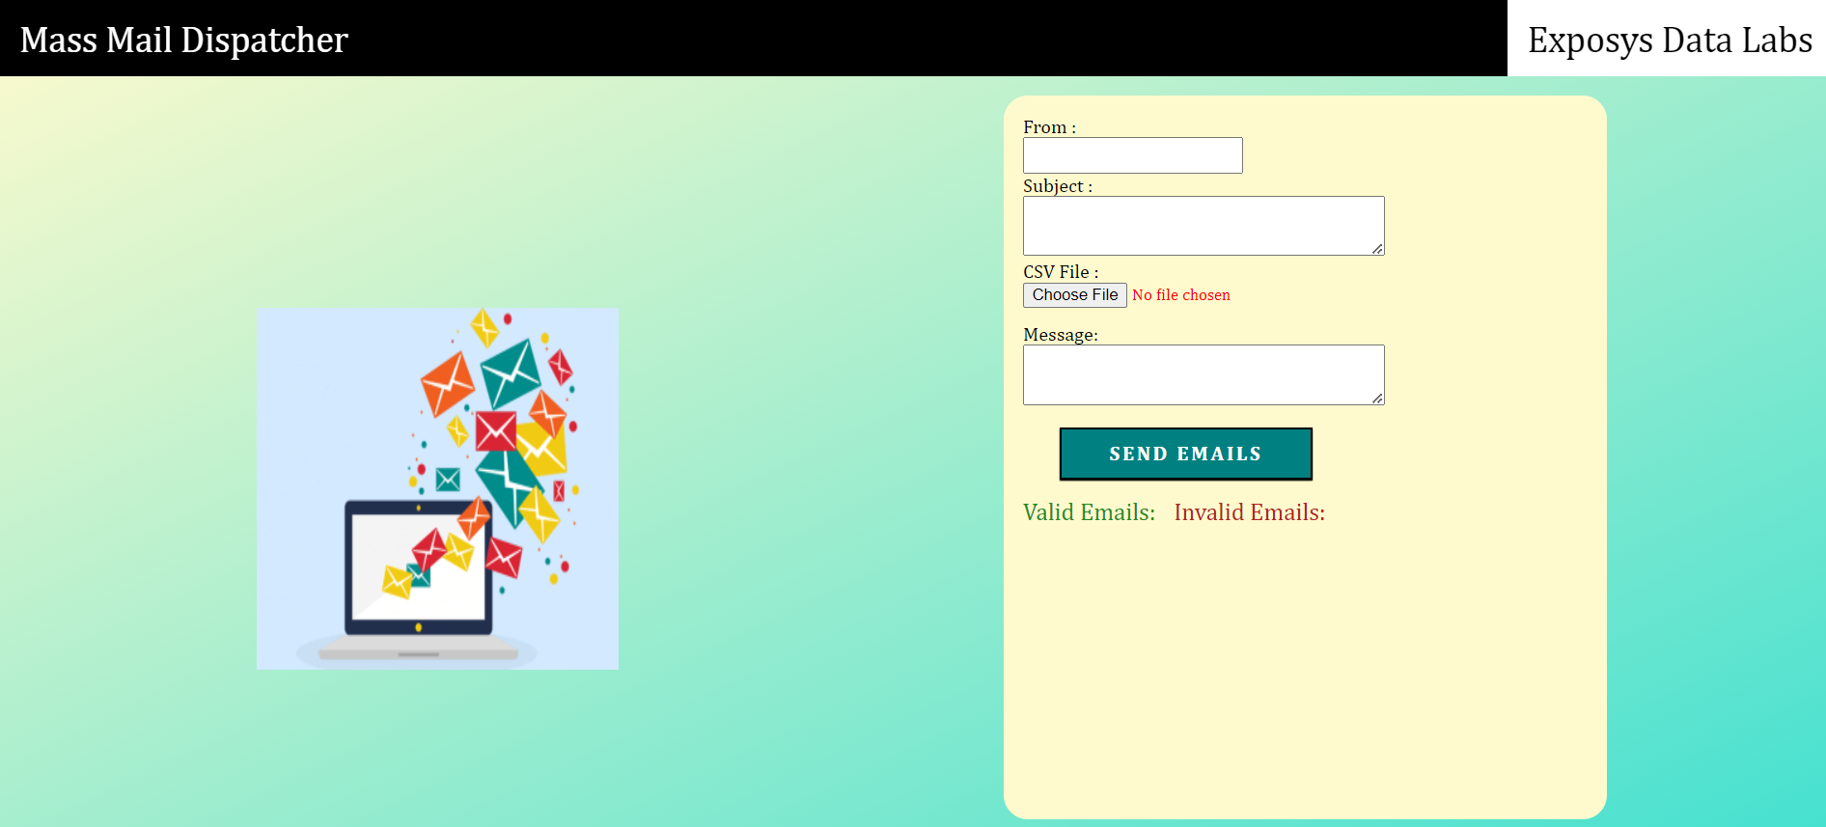
Implementation

Slide 9
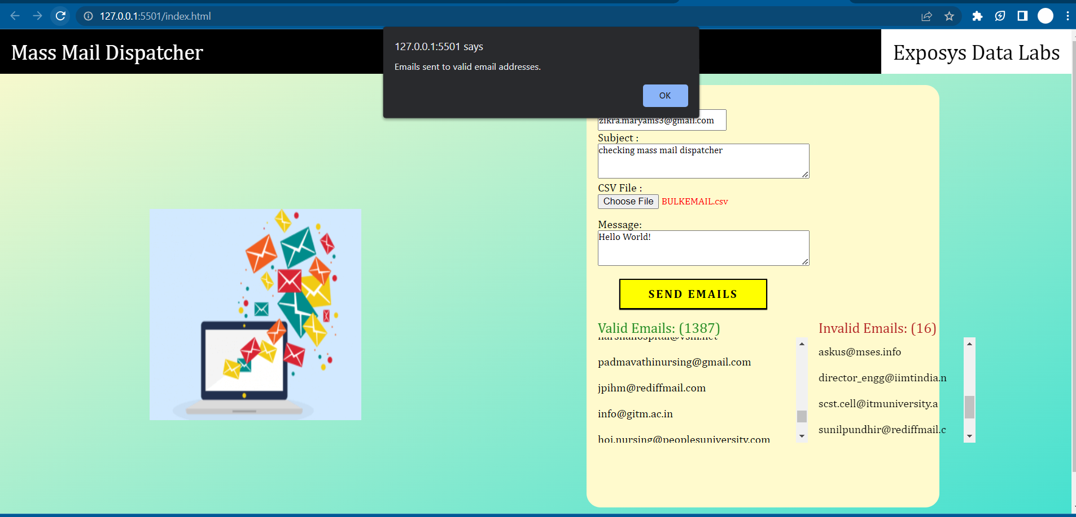

Slide 10
Conclusion
The mass mail dispatcher is simple web based application which will be useful to detect valid email ids and distinguish them from invalid email ids from the CSV file uploaded by the user.
This system will be helpful to send mails to multiple clients at a time.

